Slide 1

Detecting Flood Embankment Deterioration and Future Projection
26 February 2024
Ahmad Agus Widodo, 1st Year PhD Student
Supervisors:
Dr Truong Le (Geotechnic Sections)
Dr Philippa J Mason (Royal School of Mines)

Slide 2
Goals
Embankment Health >>> Sustainability and resiliency community
Impact of several variables to embankment health

Slide 3
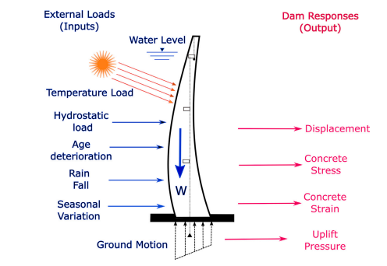
Concept
Input
process
Output
Prakash, et al. (2022)

Slide 4
Input
LIDAR | Measurement | Data Series
Water Level | Ground motion rate | Climate data
Embankment condition | Concrete stress / strain | Acid rain
Soil Condition | Uplift Pressure | Carbon dioxide
Surface features | Embankment tilt | Sulphur
 | Actual temperature, RH, chemical of water | Others.

Slide 5
Data Type
Correlation
Spatial
Quantitative
Qualitative
Ratio
Level of Importance every variable
Statistical approach will work properly depending on the type of data.
probability
Prediction / projection

Slide 6
process
Python : Math Modul, NumPy, Pandas, Matplotlib, PyVF, Scikit Learn, Statsmodel.
Probability and projection
Data
Correlation Calculation
Level of the importance each variable
Model output for use
Risk Assessment
Recommendation
Following project
Maps
Data series
Actual measurement
Regression
Anova
RMSE
Others.
Sobol’s Indices
Bayesian Analysis
Gaussian
Neural Network
Random forest
Equation, try and error

Slide 7
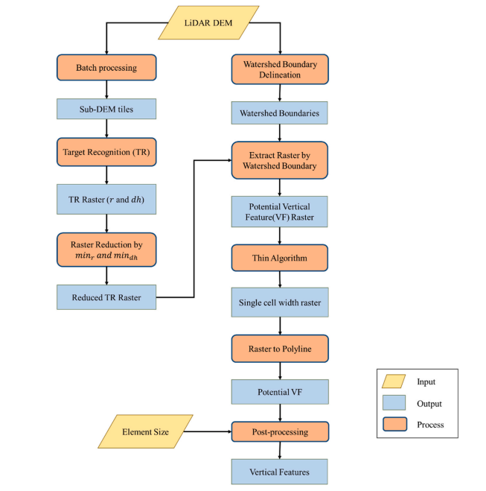
LiDAR
PyVF is an open-source program to extract significant VFs from a high-resolution, bare-earth, LiDAR-derived DEM automatically (Gao et al., 2022).
(Gao, et al., 2022)

Slide 8
By providing detailed height and intensity land surface information, high-resolution LiDAR data have proved to be effective in supporting land classification when combined with other major geospatial data sources such as hyperspectral images (Zhou et al., 2017).
Pre-processing
Object-based segmentation
Classification
output
Computing elevation difference
Extracting boundaries
Image regions (e.g. building)
Computing elevation texture
DSM
Classification result of image regions
Linear Classifier
Classification result
Computing Intensity Statistics
LiDAR Intensity data
Removing Image regions (e.g. building)
SLIC Segmentation
Super
pixels
Linear Classifier
Classification result of super pixels
Denoising/image enhancement
Computing Intensity Texture
DSM = Digital Surface Model
SLIC = Simple Linear Iterative Clustering
Hessian Matrix = detect point surface features / filtering / classification process

Slide 9
Output
Expectation:
Embankment deterioration rate.
Precise calculation of critical damage time.
Developing scenario for risk mitigation/preparedness ?

Slide 10
Issues
Do I need field measurement and Data measurement? if yes, Are the tools properly calibrated and affordable to buy?
Data Sources / availability (time series data of climate, chemical, others).
Understanding the data types
Understanding the calculation and modelling.

Slide 11
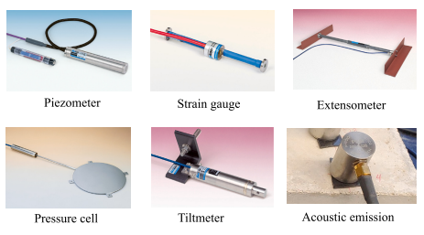
Tools ?
Soil and rock movement
Measurement tools? : soil motion rate, embankment age, water sampling (if needed).
Monitoring tools addition (if needed) : camera, drone.
Machine Learning : python.
Uplift pressure
Concrete Stress
Stress variation inside concrete
Tilt the dam
Detect the damage underground
Prakash, et al. (2022)

Slide 12
Task!
Finalising the main topic
Looking for the data type
Looking for how to treat the data.

Slide 13
Reference
Gao, S., Bilskie, M. V., & Hagen, S. C. (2022). PyVF: A python program for extracting vertical features from LiDAR-DEMs. Environmental Modelling & Software, 157, 105503.
Heinzler, R., Piewak, F., Schindler, P., & Stork, W. (2020). Cnn-based lidar point cloud de-noising in adverse weather. IEEE Robotics and Automation Letters, 5(2), 2514-2521.
Prakash, G., Dugalam, R., Barbosh, M., & Sadhu, A. (2022, October). Recent advancement of concrete dam health monitoring technology: A systematic literature review. In Structures (Vol. 44, pp. 766-784). Elsevier.
Zhou, X., & Li, W. (2017). A geographic object-based approach for land classification using LiDAR elevation and intensity. IEEE Geoscience and Remote Sensing Letters, 14(5), 669-673.

